Slide 1
Driver Drowsiness Detection System
Presented By :
Aman Jain C - 241
Dhrumil Vadgama C - 238
Himanshu Prajapati C - 226
Guided By
Prof. Rehan Ahmad

Slide 2
Outline
Introduction
Literature Survey
Objectives
Block Diagram
Proposed Methodology
Timeline
Applications
Expected Results/Conclusion
References

Slide 3
Introduction
Drowsiness detection is a safety technology that can prevent accidents that are caused by drivers who fall asleep while driving.
A countless number of people drive on the highway day and night. Taxi drivers, bus drivers, truck drivers and people traveling long-distance suffer from lack of sleep. Due to which it becomes very dangerous to drive when feeling sleepy.
The majority of accidents happen due to the drowsiness of the driver. So, to prevent these accidents we will build a system using Python, OpenCV, and Keras which will alert the driver when he feels sleepy.

Slide 4
Literature Survey
Camerabased Drowsiness Reference for Driver State Classification under Real Driving Conditions -
In June, 2010, Friedrichs & Yang described ‘Camerabased Drowsiness Reference for Driver State Classification under Real Driving Conditions’.
They proposed that measures of the driver’s eyes are capable to detect drowsiness under simulator or experiment conditions.
The performance of the latest eye tracking based in-vehicle fatigue prediction measures are evaluated. These measures are assessed statistically and by a classification method based on a large dataset of 90 hours of real road drives.
The results show that eye-tracking drowsiness detection works well for some drivers as long as the blinks detection works properly.

Slide 5
Visual Analysis of Eye State and Head Pose for Driver Alertness Monitoring -
Published in : IEEE Transactions on Intelligent Transportation Systems ( Volume: 14, Issue: 3, Sept. 2013)
They presented visual analysis of eye state and head pose (HP) for continuous monitoring of alertness of a vehicle driver.
Most existing approaches to visual detection of non-alert driving patterns rely either on eye closure or head nodding angles to determine the driver drowsiness or distraction level.
The proposed scheme uses visual features such as eye index (EI), pupil activity (PA), and HP to extract critical information on non-alertness of a vehicle driver

Slide 6
Objectives
The objective of this project is to build a drowsiness detection system that will detect that a person’s eyes are closed for a few seconds.
This system will alert the driver when drowsiness is detected by using buzzer or alarm.
The system works in various lighting conditions.

Slide 7
Block Diagram
Take Image as Input from a Camera
Using haar cascade classifier to detect faces
Drawing boundary boxes for each face
Creating a Region of Interest (ROI)
Detecting the eyes from ROI and feeding it to the classifier
Extracting the boundary box of the eye
Using CNN classifier for predicting the eye status
Calculating Score to Check whether Person is Drowsy
Drowsiness Alert

Slide 8
Proposed Methodology
In this Python project, we will be using OpenCV for gathering the images from webcam and feed them into a Deep Learning model which will classify whether the person’s eyes are ‘Open’ or ‘Closed’. The approach we will be using for this Python project is as follows :
Step 1 – Take image as input from a camera.
Step 2 – Detect the face in the image and create a Region of Interest (ROI).
Step 3 – Detect the eyes from ROI and feed it to the classifier.
Step 4 – Classifier will categorize whether eyes are open or closed.
Step 5 – Calculate score to check whether the person is drowsy.

Slide 9
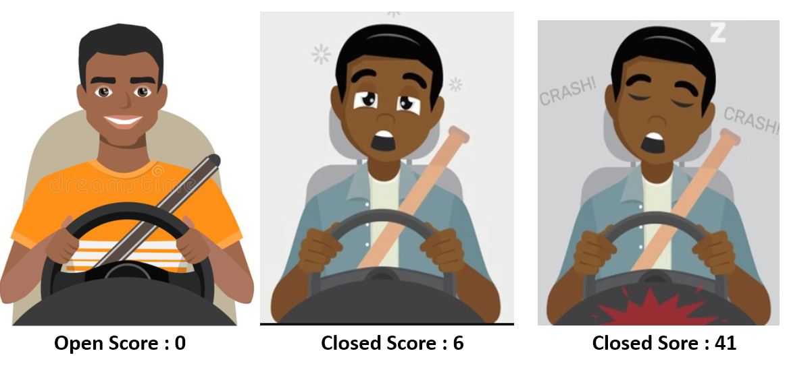
Sample Test Case

Slide 10
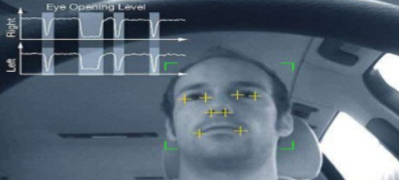
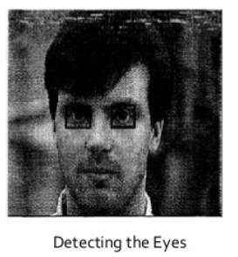
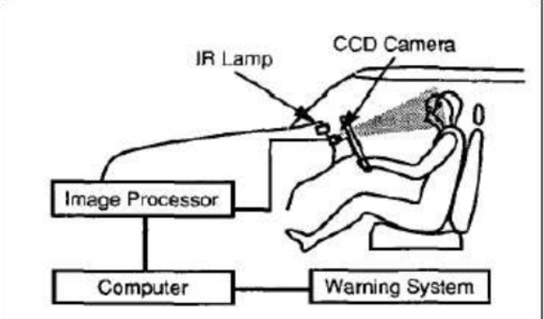
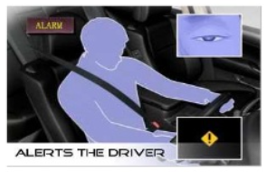

Slide 11
The Model Architecture
The model we used is built with Keras using Convolutional Neural Networks (CNN). A convolutional neural network is a special type of deep neural network which performs extremely well for image classification purposes. A CNN basically consists of an input layer, an output layer and a hidden layer which can have multiple numbers of layers. A convolution operation is performed on these layers using a filter that performs 2D matrix multiplication on the layer and filter.
Software Used -
Python 3.6
OpenCV
TensorFlow
Keras
Pygame

Slide 12
Applications
Transportation business where almost daily accidents occur due to driver fatigue.
Security guard cabins.
Operators at nuclear power plants where continuous monitoring is necessary.
Military applications where high intensity monitoring of soldier is needed.
In classroom where students feel drowsy and inattentive during the class.

Slide 13
Conclusion
In this Python project, we have built a drowsy driver alert system that we can implement in numerous ways. The system which can differentiate normal eye blink and drowsiness which can prevent the driver from entering the state of sleepiness while driving.
We used OpenCV to detect faces and eyes using a haar cascade classifier and then we used a CNN model to predict the status.

Slide 14
References
“Driver fatigue and road accidents a literature review and position paper" (PDF). Royal Society for the Prevention of Accidents. February 2001. Archived from the original (PDF) on 2017-03-01. Retrieved 2017-02-28.
"4.1.03. Driver Drowsiness Detection System for Cars". Retrieved 2015-11-05.
"Driver drowsiness detection". Robert Bosch GmbH. Retrieved 2015-11-05.
2013, G. Kong et. al. ‘Visual Analysis of Eye State and Head Pose for Driver Alertness Monitoring’
In June, 2012, A. Cheng et. al. [18] described 'Driver Drowsiness Recognition Based on Computer Vision Technology’
"Fatigue Detection". Retrieved 6 August 2014.

Slide 15
Thank You

